Slide 1
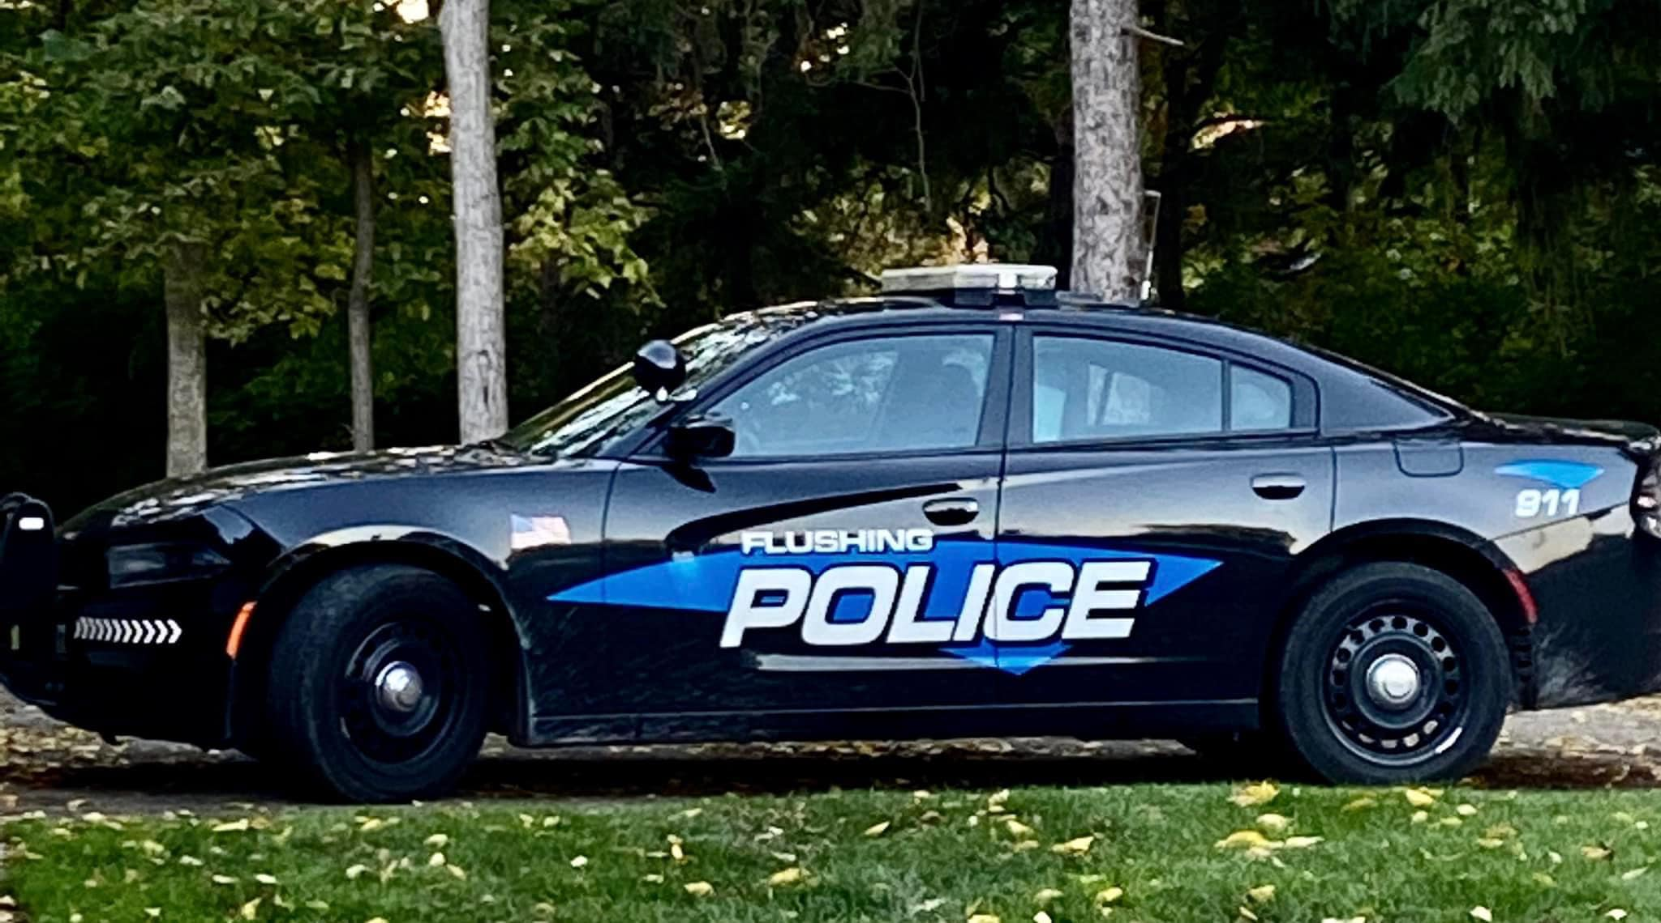
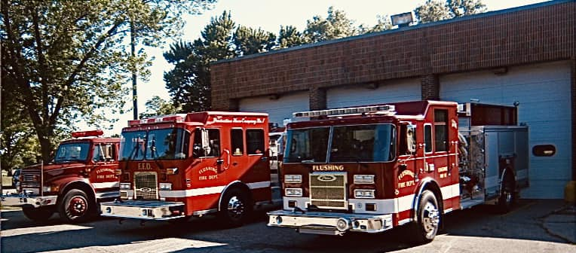
City of Flushing
Emergency Medical Services
Overview

Slide 2
How Much is a Life Worth?
Residential Properties only
Highest Assessment $664.04
Lowest Assessment $ 1.35
Average Assessment $145.19
Median Assessment $132.36
Median is the amount where ½ are higher and ½ are lower.
If your Taxable Value is less than $80,000, (more than 77% of homes in the City of Flushing) your EMS assessment will be less than .50 cents per day.
Residential & Commercial Combined
Highest Assessment $6,982.43
Lowest Assessment $ 1.22
Average Assessment $151.97
Median Assessment $130.50

Slide 3
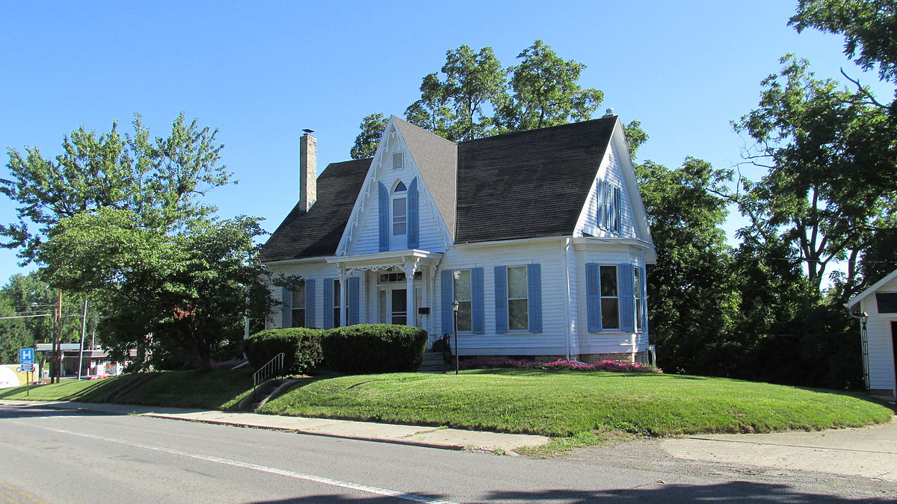
How Much is a Life Worth?
To figure your assessment:
Multiply the TAXABLE value of your property by the rate of 2.25 mills
Example TAXABLE value of $50,000
$50,000. X .00225 = 112.50
The Tax roll has not been officially set yet, nor has the millage rate for the Special Assessment,
so this number may change slightly
This Photo by Unknown Author is licensed under CC BY-SA

Slide 4
How Much is a Life Worth?
Count of FRACTIONAL_MIN | Column Labels
Row Labels | 1 | 2 | 3 | 4 | 5 | 6 | 7 | 8 | 9 | 10 | 11 | 12 | 13 | 14 | 15 | 16 | 17 | 18 | 19 | 20 | 21 | 22 | 23 | 25 | 26+ | Grand Total | 2022 Fractile Response Time
1 | 2 | 4 | 6 | 11 | 28 | 21 | 33 | 46 | 29 | 36 | 42 | 30 | 25 | 45 | 26 | 28 | 10 | 11 | 7 | 12 | 2 | 4 | 2 | 2 | 32 | 494 | 36.44%
2 | 1 | 2 | 3 | 4 | 10 | 14 | 13 | 17 | 14 | 15 | 17 | 23 | 29 | 17 | 23 | 23 | 17 | 20 | 19 | 20 | 6 | 10 | 2 | 11 | 67 | 397 | 33.50%
Grand Total | 3 | 6 | 9 | 15 | 38 | 35 | 46 | 63 | 43 | 51 | 59 | 53 | 54 | 62 | 49 | 51 | 27 | 31 | 26 | 32 | 8 | 14 | 4 | 13 | 99 | 891 | 34.97%
Priority One (1) Fractile Response Time begins at ten (10). The reason is in the way in which 9-1-1 calculates response times. example: 8 minute 1 second is (9). 9 minute 1 second and above is (10). Priority-One response time should be 8 minutes 59 seconds 90%
Priority Two (2) Fractile Response Time begins at thirteen (13). The reason is in the way in which 9-1-1 calculates response times. Example: 11 minute 1 second is (12). 12 minute 1 second and above is (13). Priority-Two response time should be 12 minutes 59 seconds 80%
Oakland County Medical Control Authority defines 90% Fractile Value as - The value or measurement at which 90% of all events occur. This is typically used in time measurements to better standardize performance across systems.

Slide 5
How Much is a Life Worth?
EMS (proposed) Structure
PROs
EMS (proposed) Structure
CONs
No costs outside of the Special Assessment – you will not be charged
Very fast Response Times
Cannot be called outside of the area we are licensed for
Your loved one is receiving medical care by trained individuals while waiting for an ambulance
Cannot receive Medical Insurance reimbursements
Fully funded by Special Assessment
Cost is more than ambulance because there is no reimbursement
No transportation to hospital – must still wait for an ambulance for transport

Slide 6
How Much is a Life Worth?
Frequently Asked Questions
Why don’t we keep sending Police Officers to medical scenes.
The City has two officers on patrol at any one time. A medical scene takes both officers off the street and makes them unavailable to answer other calls until an ambulance arrives and the patient is stabilized.
How much is this proposal really going to decrease our response time?
First responders running from the Fire Station can get anywhere in the city in four (4) minutes or less.
Why don’t we receive better service from ambulance companies?
Ambulance companies are experiencing the same staffing shortage issues that every other industry in the nation is experiencing, for a variety of reasons.

Slide 7
How much is a Life Worth?
But we pay a millage for the Sheriff’s Department Paramedics, why can’t they pick up the slack?
The Sheriff’s Department is bogged down with calls from other communities, the same as ambulances. Even though every property pays .4743 mills for Paramedics, the city only received paramedic response about 19% of the time.
Why don’t we just contract with an ambulance company like other communities?
Simply contracting with a company will not solve the problem. Genesee County 911 is still, by law, required to dispatch the closest ambulance to the scene. In addition, Genesee County 911 requires that the City indemnify them from liability for not doing so. Further, many communities who have contracted are not seeing dramatic results.

Slide 8
How Much is a Life Worth?
We are living in what some call a Public Health Crisis
Long emergency room wait times – a reality due to the mass exodus of health care professionals during the Covid-19 pandemic
Lack of available EMS/Ambulance/Paramedics – available resources stretched too thin
Staffing shortages in Healthcare and Emergency Services – Many facilities and agencies are dealing with vacancy rates approaching 20%; Michigan lost approximately 1,700 daily staffed hospital beds statewide between Oct 2020 through 2022. (Michigan Health and Hospital Association)
“If I take an ambulance I will be seen in the Emergency Room faster.” – This is a common misconception that is bogging down the system, the truth is that if you call an ambulance for a minor issue, not only will you wait, but the ambulance and it’s personnel are tied up until you have been evaluated by medical staff.

Slide 9
How Much is a Life Worth?
Approximate cost to become and EMT = $3,300 and 194 hours of training
Entry level wage = $12 - $14 per hour
Approximate Cost to become a Paramedic = $11,000; 9-15 months and more than 1,000 hours of class time
Entry level wage = $14 - $20 per hour
Approximate cost to work in fast food = $0
Entry level wage = $10.45 - $21.76 per hour
Current Issues Challenging Emergency Medical Services
EMS Programs decreasing
After EMT and Medic training, employees leave for states and communities with better pay
Approval of training programs switched from state oversight to a national accreditation body, reducing training facilities due to costs and hassle
EMT and Paramedics recruited by hospital emergency rooms where pay is better

